Slide 1



Loupe Browser Introduction ScRNAseq in the Cloud
MDIBL Comparative Genomics and Data Science Core

Slide 2
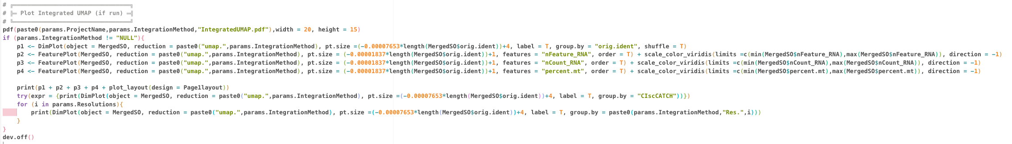
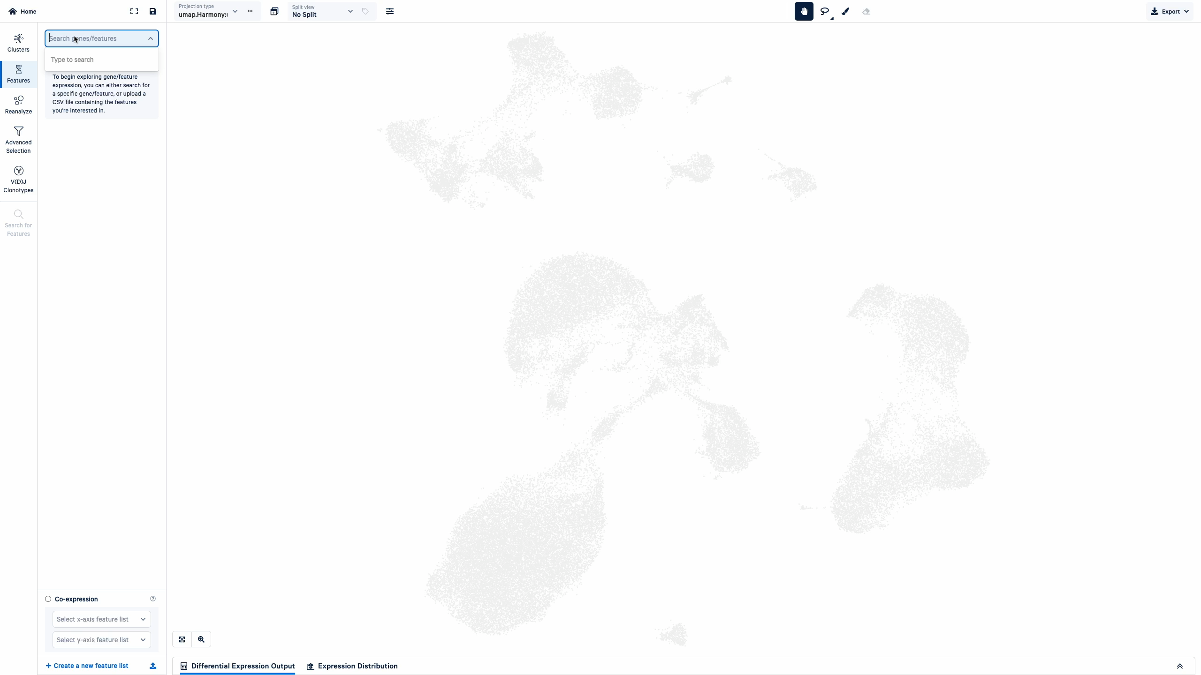
WHY
VS
Notes:
Why use Loupe Browser??
This is the alternative. Everything that we will explore can be done using a program such as R using packages such as Seurat
But you guys probably don’t want to learn that.
That whole chunk of code above can be done in just a few clicks in the loupe browser.
Sooo…. What does the loupe browser look like?

Slide 3
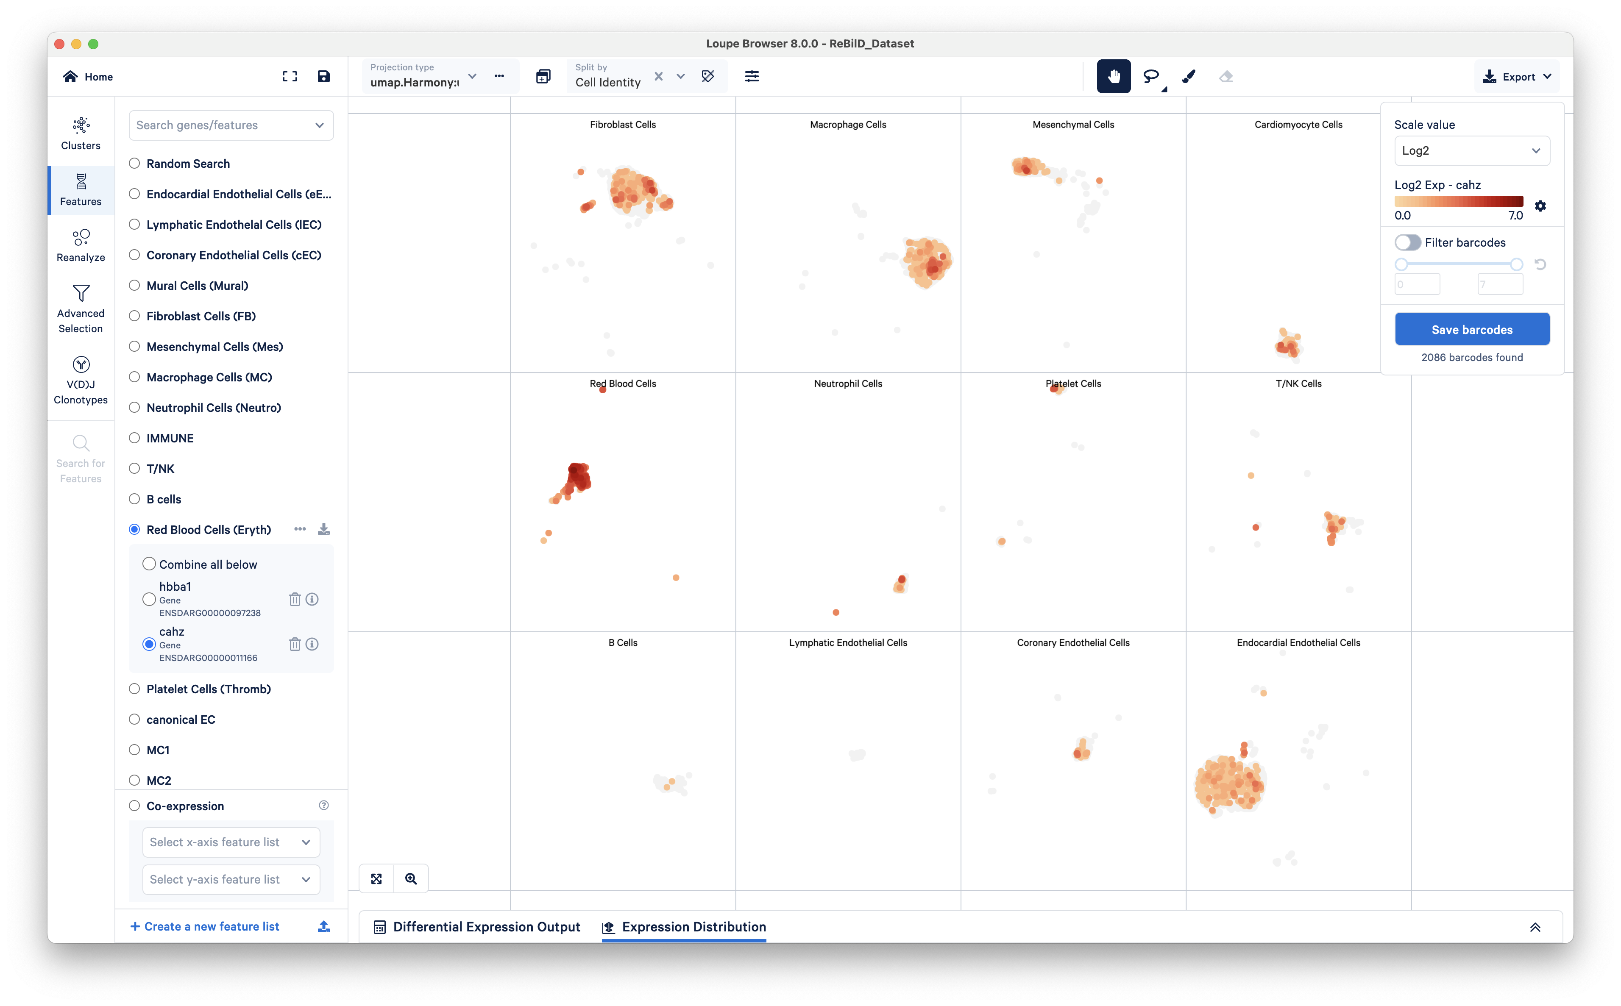
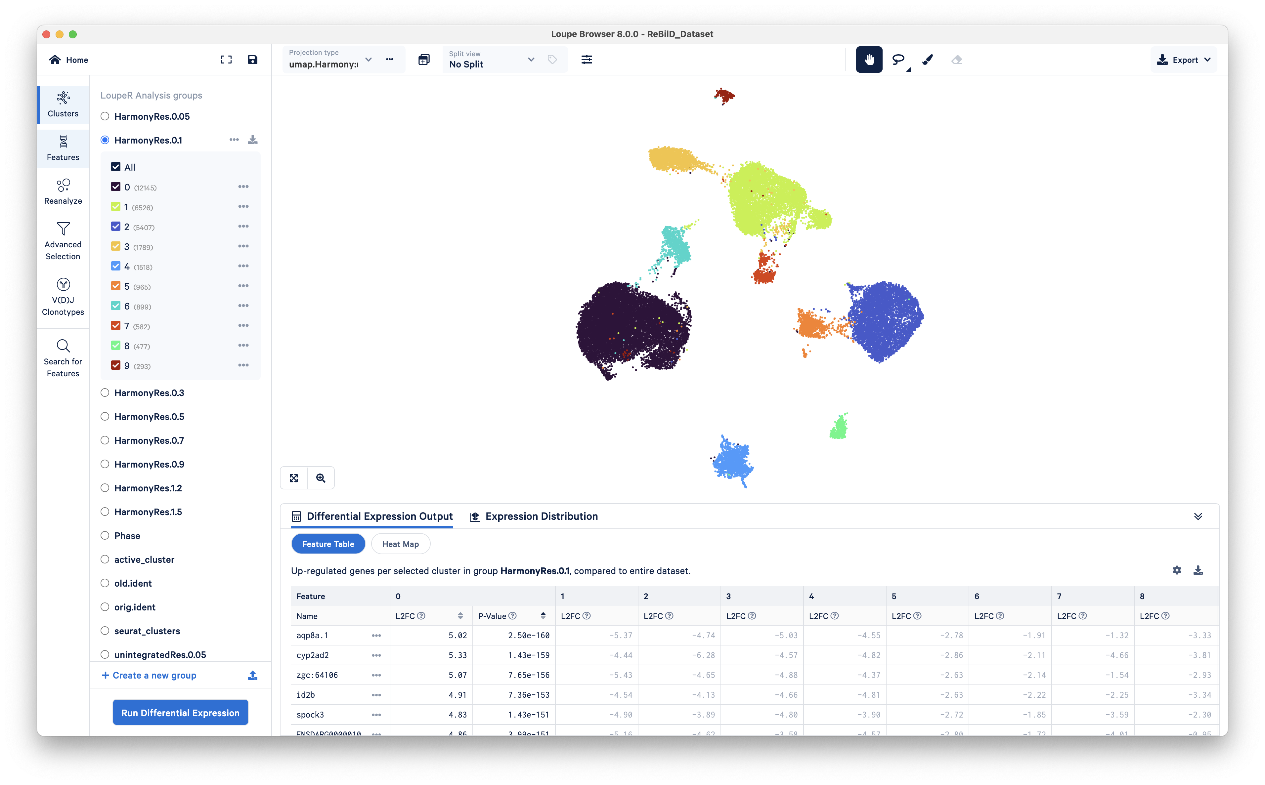
INTERFACE
Tools
View
Mouse
Export
Modes
Notes:
Here is the main interface:
Modes: here we have a selector for the various different sections which we will cover in a few minutes.
Tools: The one on the left is for hiding the left hand side panel.
View: Here you can split the view that you have into various sections. For example, different strains, or different time points. WE will take a look at this in just a moment
Mouse: here you can decide how to use your mouse. We will play oround with the various options avalible here but generally it is for panning and selecting cells.
Export: pretty self explanatory, it is designed for exporting your plots and tables that can be produced within the browser.

Slide 4
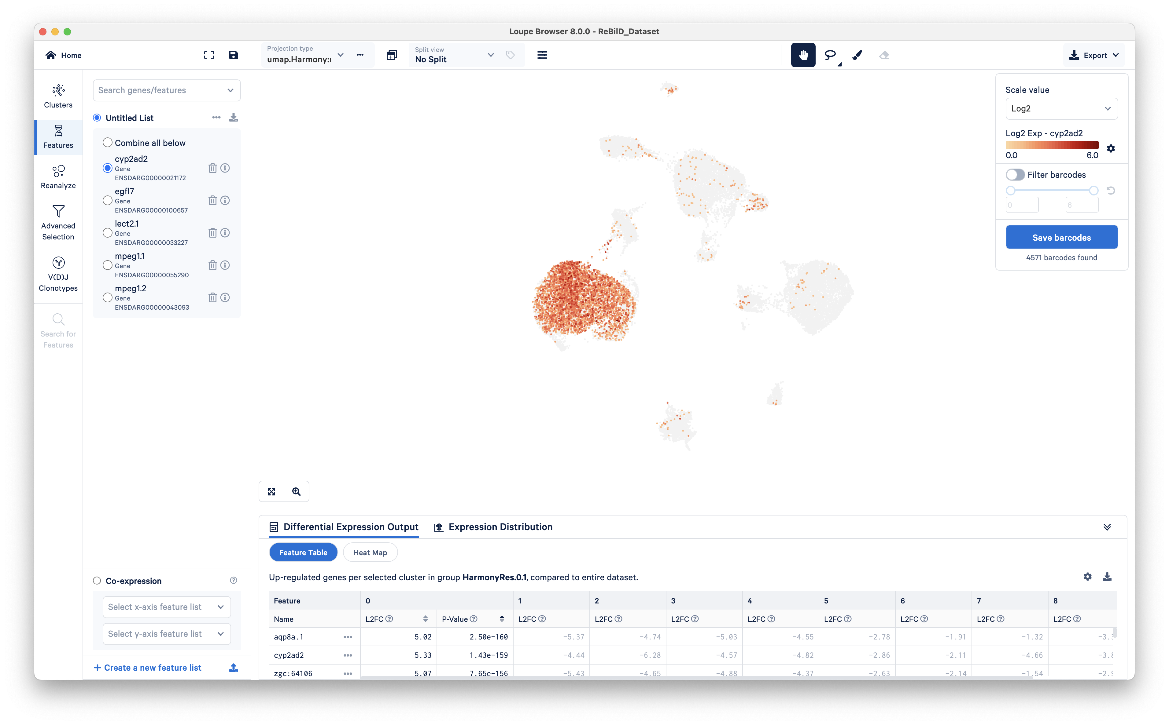
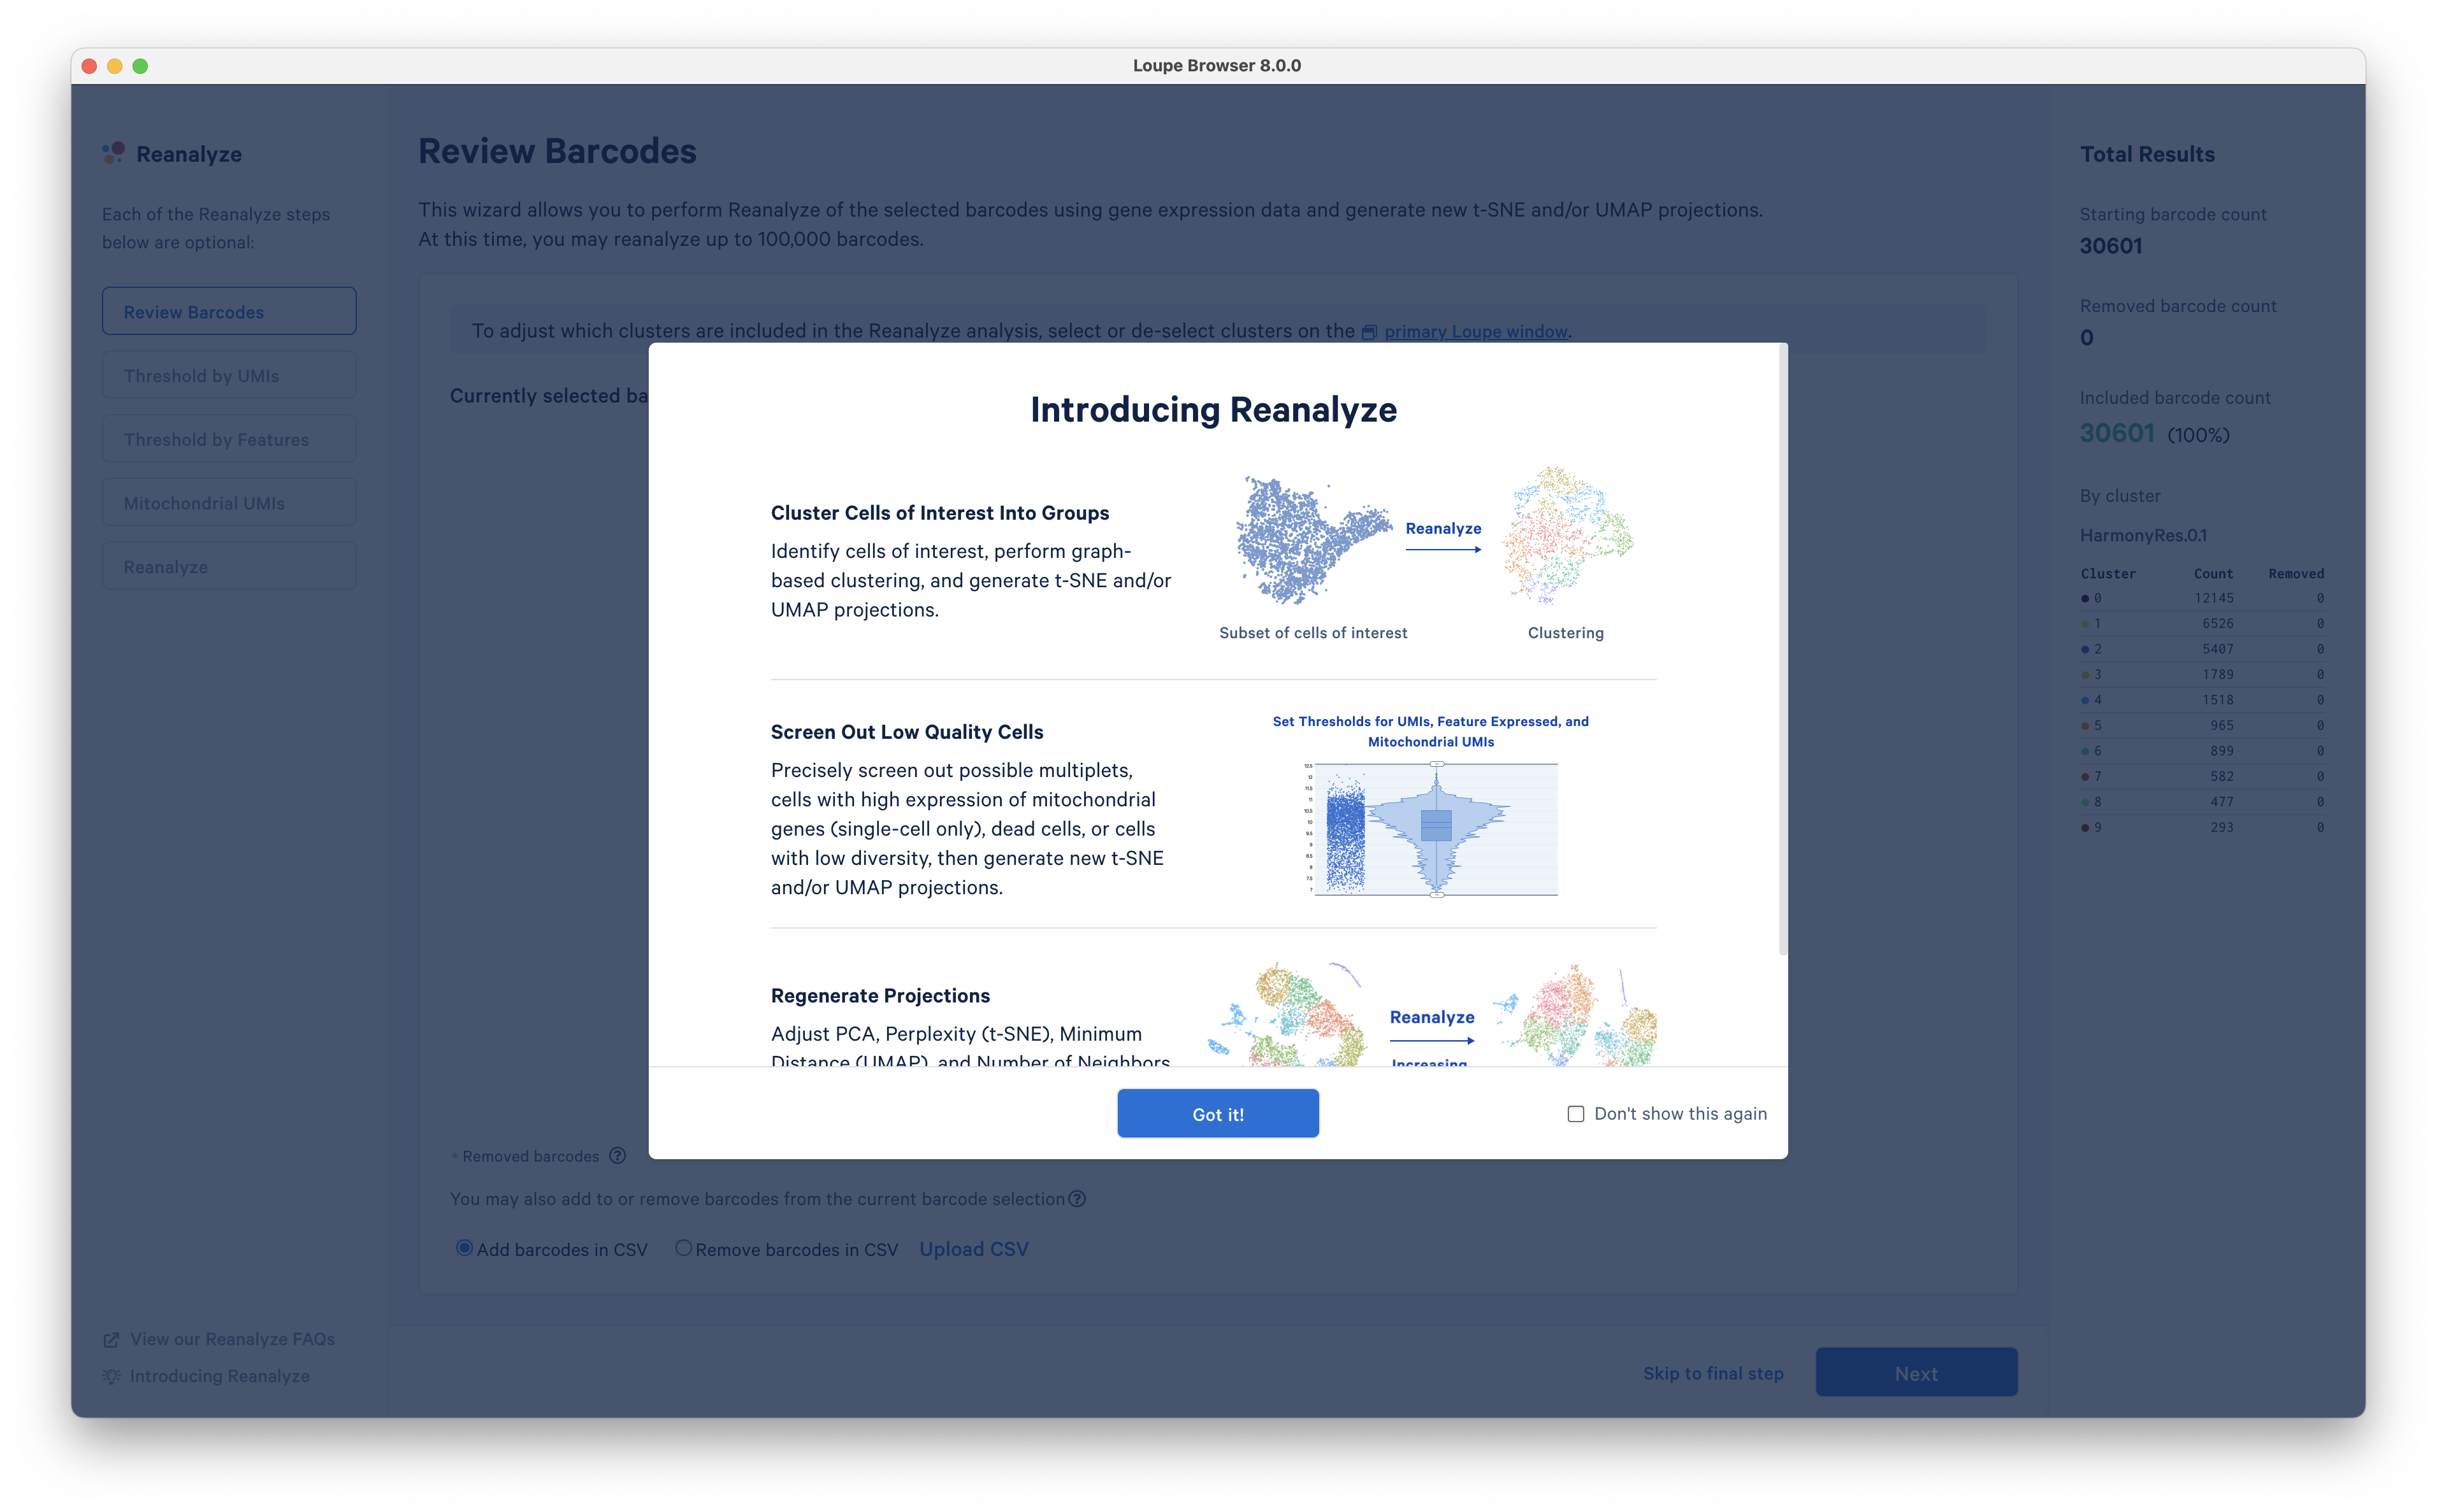
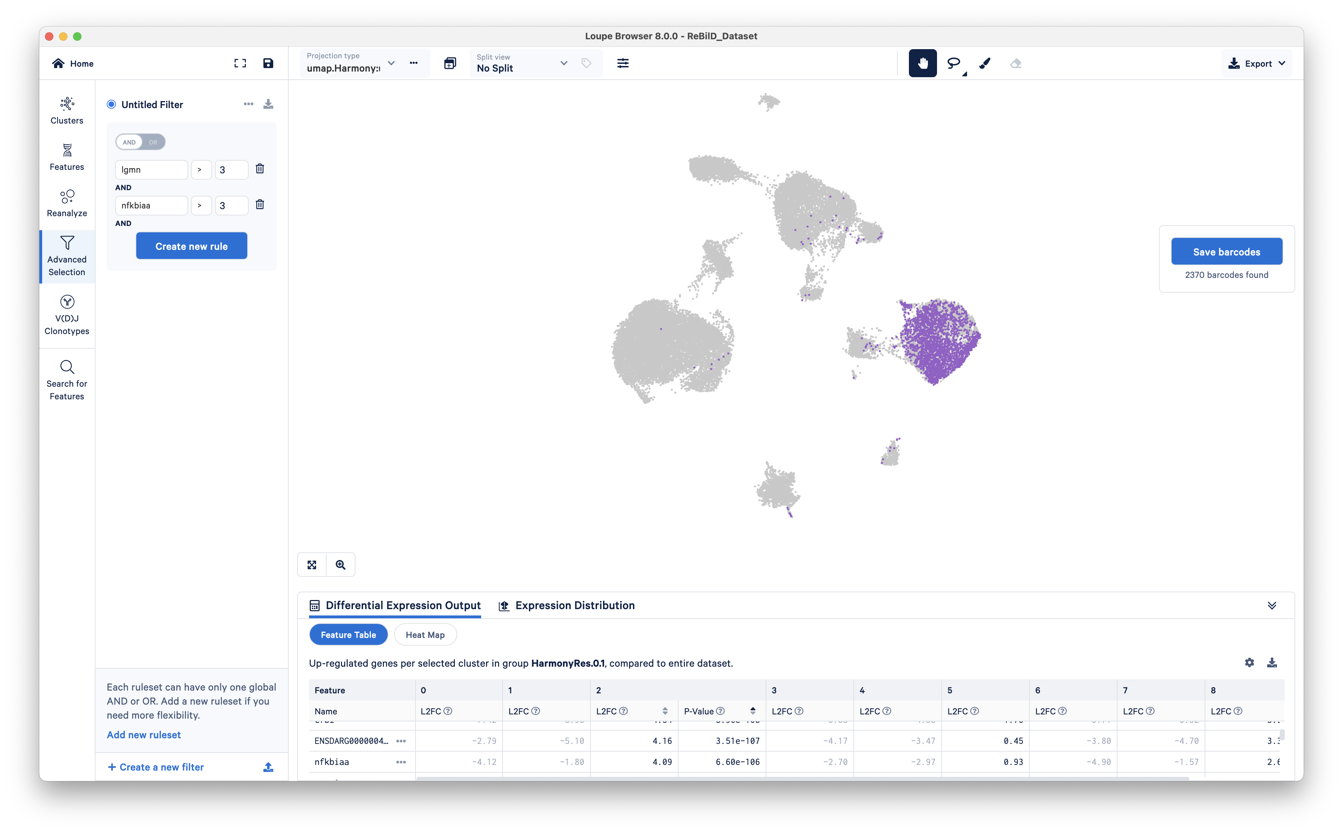
MODES
Clusters
Features
Reanalyze
Advanced Selection

Slide 5
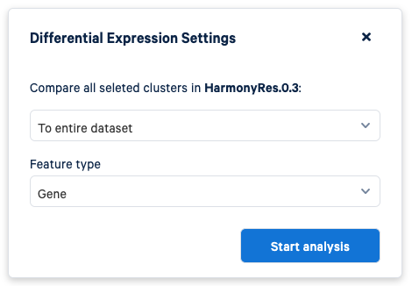
CLUSTERS
Notes:
Analysis Groups (In Seurat, these are called metadata Columns)
Each ”Column” Each one is a different way to “organize your cells.
Some of these clusters include:
Harmony vs Unintegrated: Integration is a processes used to align data across different batches or conditions while preserving the biological variation. This is in effort to eliminate the technical artifacts and be left with the biological variation.
Resolutions: Level of Sepcificity or granularity: One way to think of it is by thinking of a global map
We could consider 0.1 Resolution to be Cont. (North America, Africa, Asia, Europe, etc.)
Maybe a higher resolution 0.5 would be More specific, Countries.
And an even higher Resolution, 0.9 States
And then Counties or Cities. At 1.5 Resolution
Orig Ident/Old Ident – Samples
For any specific Group: Run Differential Expression (MARKER GENES)
For each selected cluster in a group, identify features that are upregulated in a given cluster relative to all other clusters in the dataset and find the features that distinguish that cluster from every other cluster in the dataset.
Given a Table, shown at the bottom that shows the distinguishing genes for each cluster (marker genes)+++++++

Slide 6
FEATURES
Notes:
In features, you are looking at specific genes as you saw in the initial demonstration on the second slide.
You can create specific lists—for example known marker genes for a specific cell type.

Slide 7
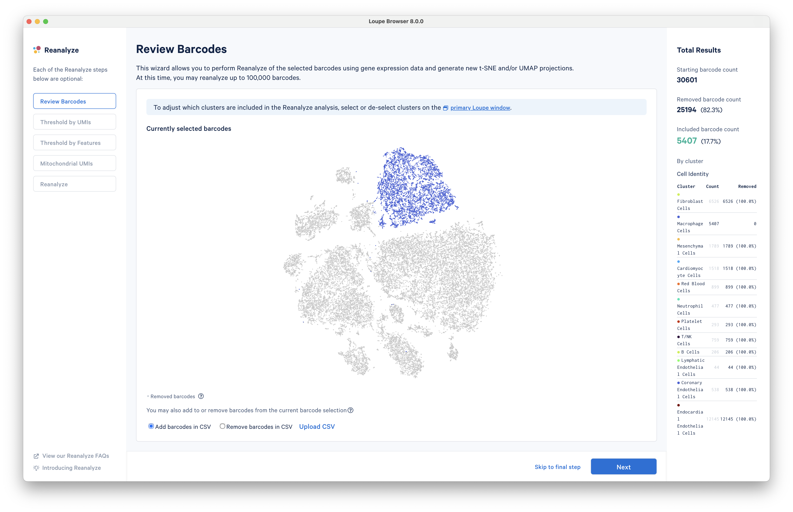
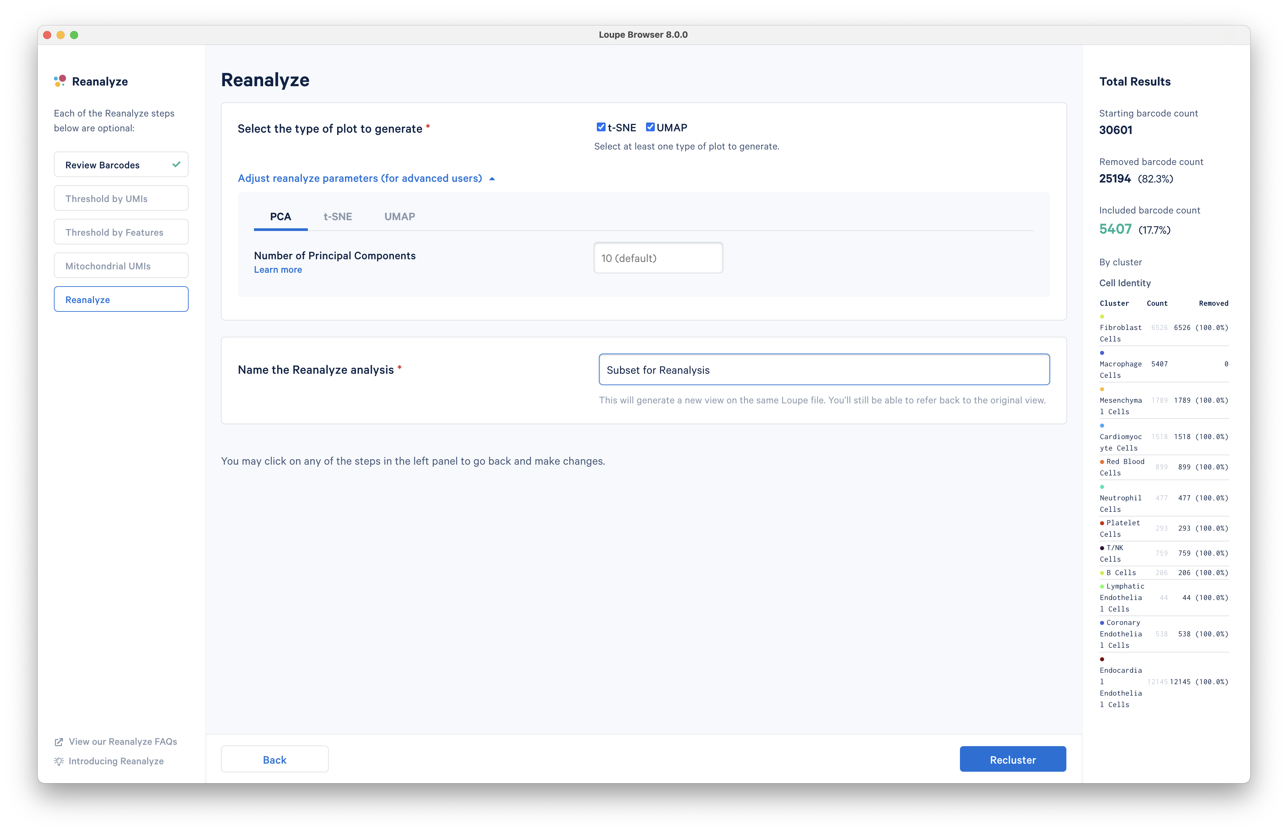
REANALYZE
Notes:
I reanalyze, the main utility of this is to dive deeper into a specific cell type.
Later on, we will explore this and see how it can be useful in the dataset that we will be working with.

Slide 8
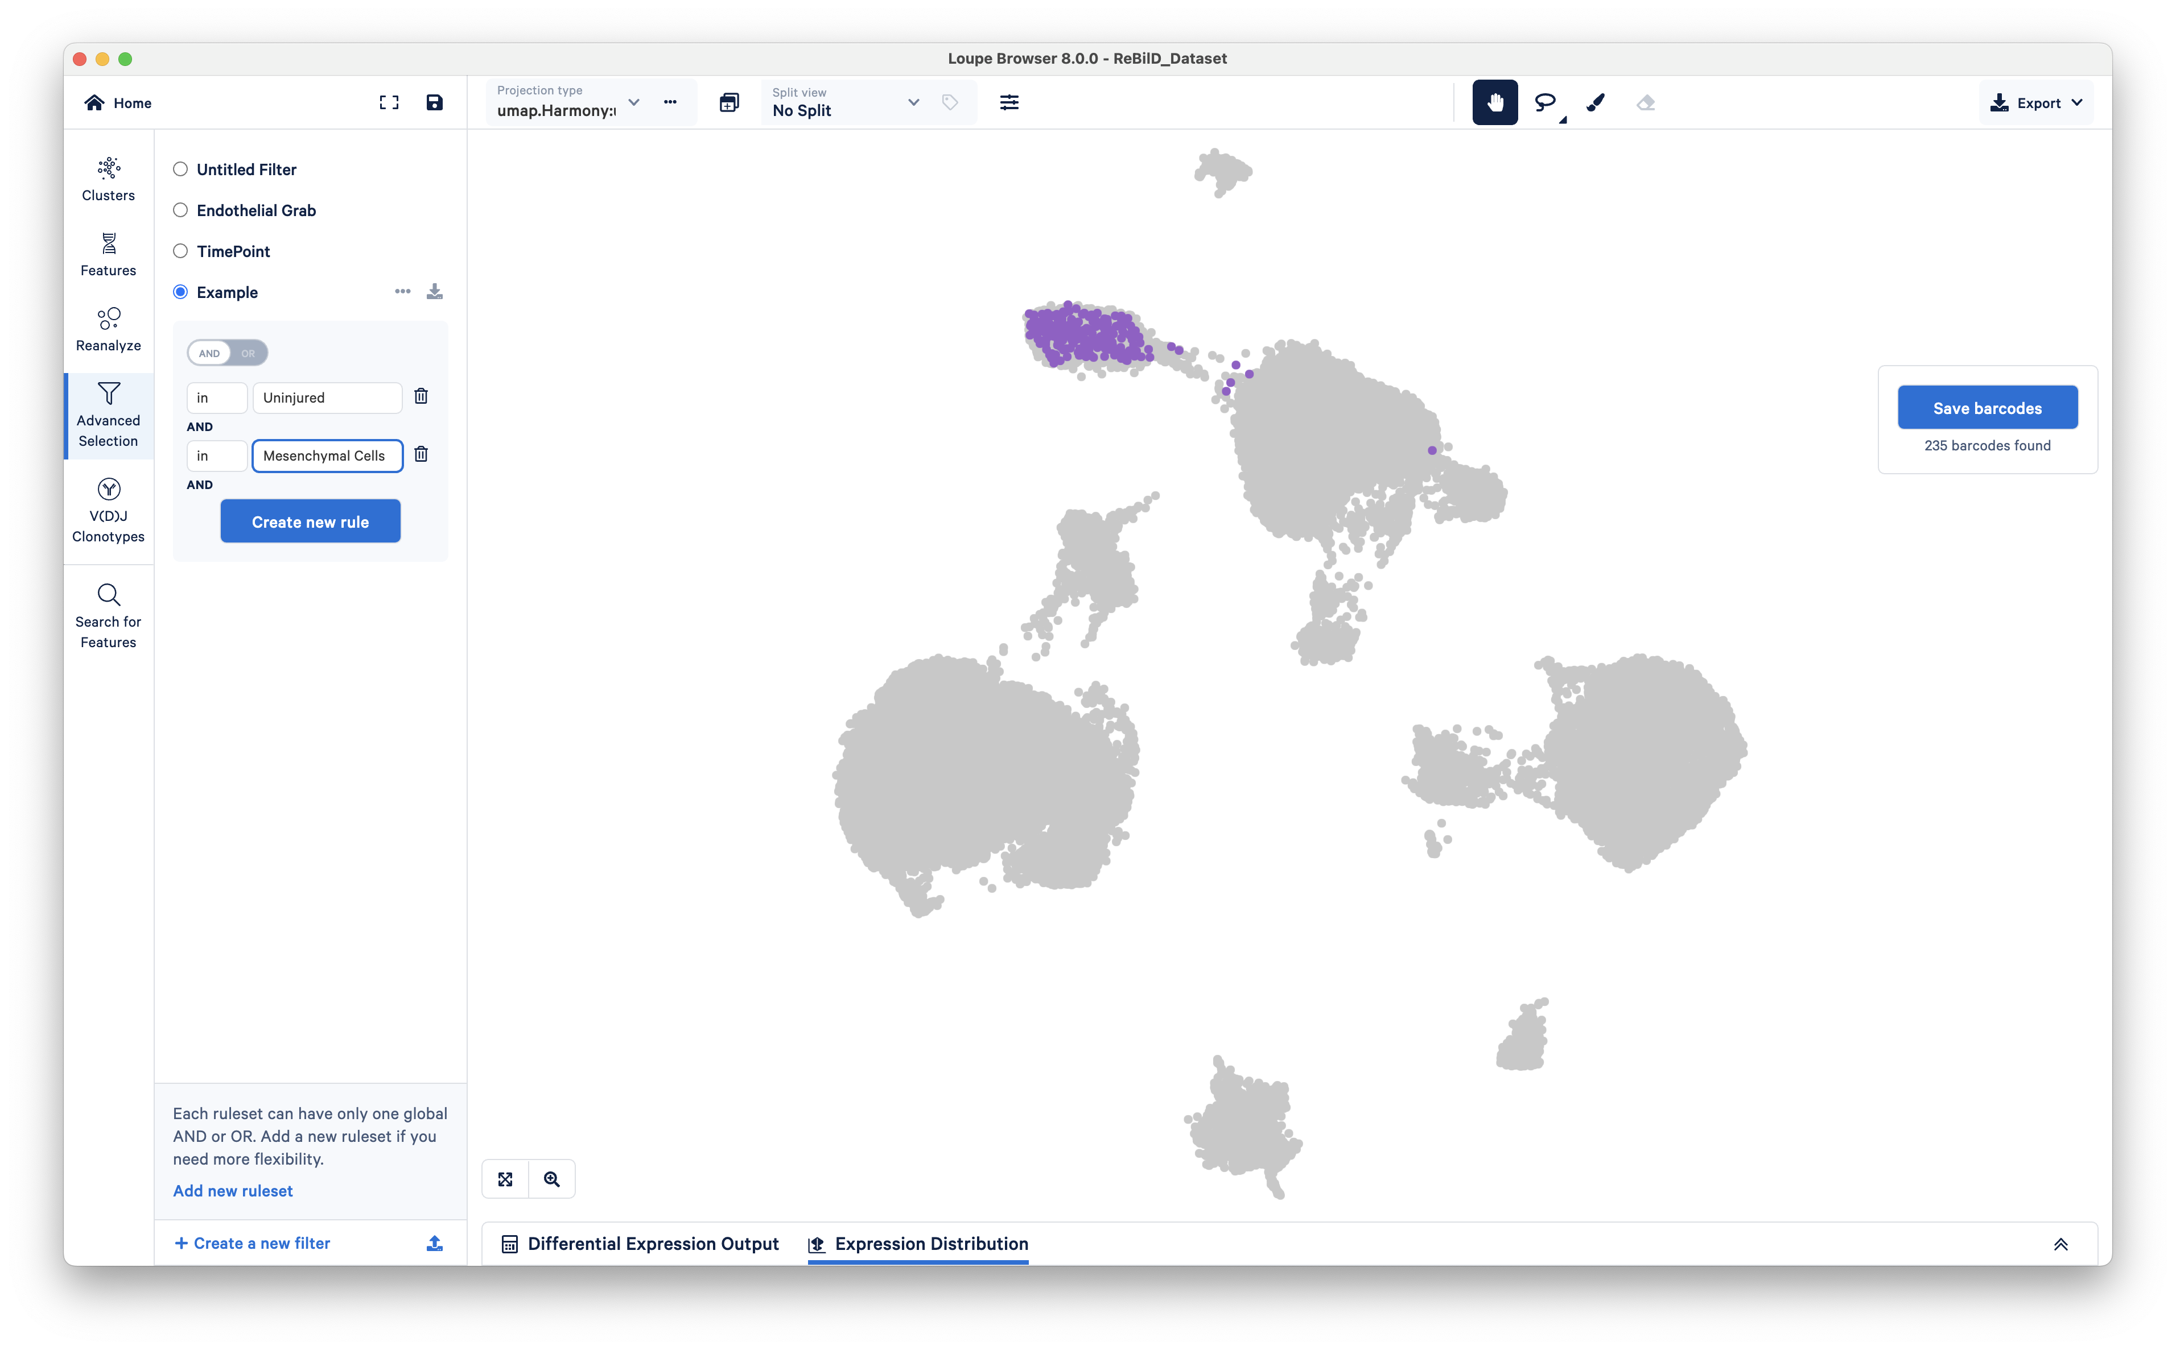
ADVANCED SELECTION
Notes:
There are many different ways to select cells. Advanced selection gives you the most “systematic” way of doing so.
I’ll show you what I mean if a little bit.

Slide 9
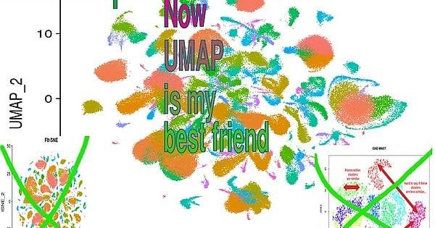

Questions?

